Slide 1


Data Types
Data Types
In java

Slide 2

Data Types in java
Data types in java, define the kind of data a variable can store, such as numbers, characters, or true/false values.
By :- Tech Squad
This Photo by Unknown Author is licensed under CC BY-SA

Slide 3
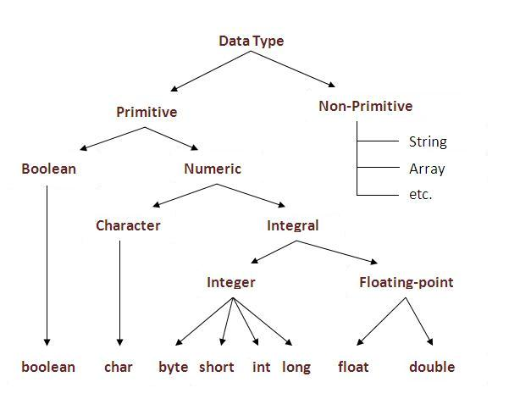
Types of Data Type:
Primitive :
A primitive data type in Java is a pre-defined, basic data type like int, char, float, or boolean that stores simple values directly.
Non-Primitive:
Non-primitive data types in Java store references to complex objects rather than actual values. Examples include String, array, class, interface, and enum types.

Slide 4
Numeric : Data type
Byte, short, int, long, float, double
Byte:
Stores Numeric value
Size: 8 bits (1 byte)
Range: from -128 to 127
Useful for memory savings in large data
Syntax :
byte variableName = value;

Slide 5
Numeric : Data type
Short:
Stores Numeric value
Size: 16 bits (2 Bytes)
Range: from -32,768 to 32,767
Syntax :
short variableName = value;

Slide 6
Numeric : Data type
Byte, short, int, long, float, double
Integer:
Stores Numeric value
Size: Size: 32 bits (4 bytes)
Range: From -2,147,483,648 to 2,147,483,647
Used to store integer values without decimals
Suitable for general-purpose integer calculations
Syntax :
int variableName = value;

Slide 7
Numeric : Data type
Byte, short, int, long, float, double
Long:
Stores Numeric value
Size: 64 bits (8 bytes)
Range: -9,223,372,036,854,775,808 to 9,223,372,036,854,775,807
Used when interger value larger than int are needed.
Syntax :
long variableName = valueL;
Example :
long distance = 9876543210L;;

Slide 8
Numeric : Data type
Byte, short, int, long, float, double
Float :
Stores fraction or decimal value
Size: 32 bits (4 bytes)
Less precise than double but uses less memory
Used to store decimal numbers with fractional parts (e.g., 3.14)
Syntax :
byte variableName = valuef;
example :
float pi = 3.14f;

Slide 9
Numeric : Data type
Byte, short, int, long, float, double
double:
Stores larger decimal or fractional value
Size: 64 bits (8 bytes)
Stores decimal numbers with fractional parts (e.g., 3.14159)
More precise than float
Syntax :
double variableName = value;
Example :
double pi = 3.14159;

Slide 10
Primitive Data type
Character, Boolean,
Character
Stores larger character value
Size: 2 bytes (16 bits) of memory.
Stores The range is from '\u0000' (0) to '\uffff' (65,535), supporting all Unicode characters.
Syntax :
char variableName = ‘value’;
Example :
char pi = ‘3.14159’;

Slide 11
Primitive Data type
Character, Boolean,
Boolean
Stores True or false
Size: Size: Java does not define its exact size, but it's usually 1 bit or 1 byte, depending on the JVM.
It represents simple yes/no or on/off conditions.
.
Syntax :
boolean variableName = true/false;
Example :
boolean b = true;

Slide 12
Non Primitive Data types :
Non primitive or user define data types in java are the data types which do not hold the actual value but the reference to the address of where the actual value is stored in the memory.
String: A sequence of characters used to store text.]
Syntax :
String variableName = “value”;
Array: A collection of elements of the same type.
Syntax :
datatype variableName [size] = {val1, val2,… valn};
Class: A user-defined blueprint for creating objects with properties and behaviors.
Syntax :
ClassName varibleName = new ClassName;

Slide 13
Thank You
Tech squad

